Slide 1


Pikuach
Governors Session 27/06/23

Slide 2
Pikuach Inspections
To consider what Pikuach would seek to find in their own school and why.
2.To help understand the new criteria of JP&SD from ‘doing to being’ activities
Q & A session for governors to feel clearer about Pikuach.

Slide 3
What makes a good inspection ?
How does your school make the most of their inspection ?

Slide 4
The core principles for a Pikuach inspection
A Pikuach inspection seeks to start from:
a) what, if any, knowledge, skills, understanding and attitudes the school seeks to impart to its pupils that enable them to enjoy their Jewish Studies and to function as motivated, knowledgeable and skilled participants in Jewish religious and communal life, and in the wider community; and
b) what, if anything, the school seeks to do to promote the development of its pupils’ spiritual personality and well-being in order for them to be inspired by Jewish faith, by awe and wonder at the created world, by concern for all humankind and by a desire to live as a sacred people.

Slide 5
Not everything changes
Inspecting a school against its own criteria
Quality of Jewish Education
Leadership, Governance & Management
Schools still Preparing for the Pikuach Inspection Process
Participation of the Headteacher or Senior Staff in Joint Lesson Observations and Arrangements for Verbal Feedback
Meetings of Inspectors with School Leaders
Reaching Final Judgements Overall Effectiveness
Providing Inspection Feedback

Slide 6
1. A pikuach inspection moving forwards.
2. Spirituality – The new bit - Why is this an important change for Your school.
3. Activity - Spirituality between others - Connecting -Sharing a thought - blessing - listening hearing responding.
Break out room & in person activity in pairs

Slide 7
Connecting to or Between Others
Moving from ourselves to someone else
Thinking/ reflecting about an issue something we want need help with something.
Listening to the other person , hearing what they are saying
Empathising
Considering what they need and want
Providing the other person with a few words to support that .
How does it make them feel ?
How does it make you feel ?

Slide 8
What is spirituality ?
To yourself
Between others
Connecting it with the world
Connected to the divine
How can you look to introduce JP&SD more into the Jewish learning experiences at your school and in the classroom ?
Begin with ourselves.

Slide 9
Personal Spirituality
One thing that can be provided for you ?
Internally- being - doing
Head to the heart- feelings- connection to oneself
Links to yourself , others to the greater world /God
Why is this so important ?
How does it help you and our students ?

Slide 10
This linking up of their Heart to their Head is part of a pupil connecting with themselves, with others in the world around them, and the divine presence in the world.
JP&SD- Four Strands
אֶמוּנָה Acknowledging the Divine
The Connection between God and our World E.g. To give thanks to something greater than themselves
צֶלֶם אֱלֹקִים Awareness of the spiritual in all
The Connection between Human Beings E.g. Can they realise that their actions can give rise to certain feelings in others; for example, happiness, pain, gratitude, envy.
מוֹרָא Experiencing spiritual awe and wonder
Awe and wonder at the world around them
E.g. Picking up litter, recycling, reduce pollution ,looking after their world, Hashems world, ‘Tu Bish Vat’ planting trees growing things contributing to the world around us
קְדוּשָה Experiencing holiness in everyday life
The Connections in Practice, to what extent pupils find meaning through being spiritually intelligent and expressing themselves in spiritual activities or restraint E.g. Prayer

Slide 11
Handbook changes
Approach to inspection
Pikuach has the following three key judgement areas:
1.Quality of Jewish Education
2.Jewish Personal and Spiritual Development
3.Leadership and Management
All leading to
Overall Effectiveness
Quality of Jewish Education
Intent the curriculum
Implementation - teaching and assessment
Impact - the resulting outcomes

Slide 12
Main changes – To Procedure
Department for education allows and extension from 5 years to 8 years for the most recent s48 report
5 working days’ notice instead of 1 day.
All stakeholders have a greater voice
We aim to clear the backlog by 2025
We are letting all schools know the year in which their inspections will hopefully take place.

Slide 13
The school’s voice -Pupil/Student/Staff Survey
Now
Surveying pupils/students/Staff electronically
Surveying staff electronically
Surveying parents electronically
Pupil Survey
Primary level - Years 5-6.
Secondary level - Years 9-10.
Questions in Handbook. Appendix 5 p. 70
All schools should have received a hard copy of Handbook.
The Handbook also online at : pikuach.org.uk

Slide 14
Ask your SLT what it looks like, bringing JP&SD into the classroom learning?
Any Q’s

Slide 15
Equality of provision
In making judgements, inspectors will consider whether the school’s provision for Jewish education is equally meaningful for both boys and girls. This does not mean that inspectors will always expect to see the same curriculum content for both male and female pupils, but in cases where the content does differ, the quality of Jewish education provided should be the same.

Slide 16
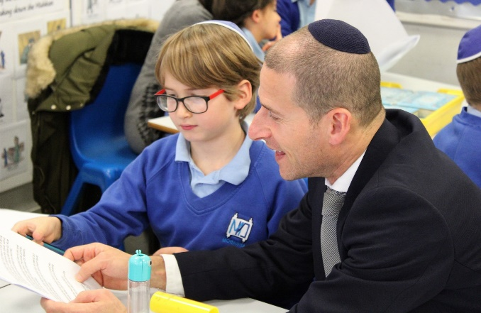
Key Area 1: The Quality of Jewish Education
Inspectors consider
the extent to which the school’s Jewish curriculum sets out the knowledge and skills that pupils will gain at each stage (intent)
the way the Jewish curriculum is taught and assessed to support pupils to build their Jewish knowledge, and to apply that knowledge as skills (implementation)
the outcomes that pupils achieve over time as a result of the Jewish education they have received (impact).

Slide 17
Examples of Grade Criteria for Quality of Jewish Education through Curriculum
Intent (Good)
The Jewish curriculum encourages well-organised, imaginative and effective opportunities for learning through a broad range of experiences which contribute well to the pupils’ Jewish knowledge, skills, spiritual development and well-being.
Implementation (Good)
Teachers create a positive environment that allows pupils to focus on their Jewish learning in an atmosphere of respect and inclusion, irrespective of their background, gender, religiosity and culture .This promotes among pupils a positive attitude towards Jewish education and learning.
Impact (Good)
Pupils develop some of the following skills in Jewish Studies/ Education: enquiry, analysis, interpretation, evaluation, reflection and curiosity.

Slide 18
The most significant change
Jewish Personal and Spiritual development
Pikuach is shifting its focus from inspecting the acquisition of Jewish knowledge to the impact Jewish learning makes on young Jewish lives. Pikauch believes that our children need to find an emotional connection to their learning and recognise its personal relevance. If not everything they learn will remain detached from their lives.
This doesn’t mean we will not be inspecting Jewish knowledge and practice.
We regard the inspection process, as a partnership between Pikuach and Jewish schools, working together to provide a rich and meaningful educational experience for future Jewish generations.
In order to nurture these generations, it is hoped that this new handbook will help us to measure how far and effectively a Jewish school promotes the twin purposes of ‘to be, as well as to know’ – Connecting the Child’s head and their heart

Slide 19
Ask your SLT what it looks like, bringing JP&SD into the classroom learning?
What does it mean for educators on a connected spiritual level?
Linking the learning to our selves.
Thinking about the learning from a ‘being’ perspective for the students.
How can you get the students to reflect think feel about things for themselves?
Showing the students how we consider reflect feel about things how we seek to improve .

Slide 20
Bringing JP&SD into the classroom learning?
Showing the pupils/ students how it is for you as their role model . Imperfections in us
show them reality achievability
Kibud Av V’Em
Howe do you try to do it better -How can they
Bringing it back to real life today- reflecting when they have done it .
How can you apply this concept to the lessons in your school ?
Task in pairs
How can you do this in a lesson you have delivered before mark 2 more spiritual ?

Slide 21
Any Questions?

